Slide 1
If you want to build higher, dig deeper SEAMC 2016

Slide 2
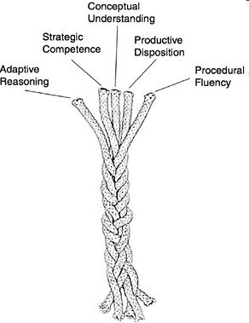
Five strands of mathematical proficiency
NRC (2001) Adding it up: Helping children learn mathematics

Slide 3
Conceptual understanding - comprehension of mathematical concepts, operations, and relations
Procedural fluency - skill in carrying out procedures flexibly, accurately, efficiently, and appropriately
Strategic competence - ability to formulate, represent, and solve mathematical problems
Adaptive reasoning - capacity for logical thought, reflection, explanation, and justification
Productive disposition - habitual inclination to see mathematics as sensible, useful, and worthwhile, coupled with a belief in diligence and one’s own efficacy.

Slide 4
NRICH Secondary Curriculum
The links take you to a selection of our favourite Secondary NRICH tasks, including our Curriculum mapping document, chosen because they are ideal for developing subject knowledge, mathematical thinking, problem-solving skills and good mathematical habits.

Slide 5
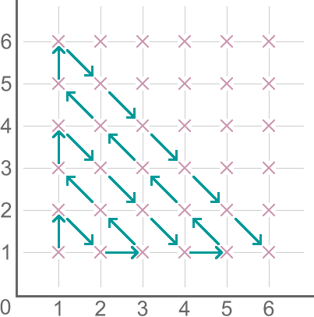
Route to Infinity
Try to list the coordinates of the points in the order in which they're visited.

Slide 6
Route to Infinity
Which point will be visited after (18,17)?
How many points will be visited before reaching (9,4)?

Slide 7
M, M and M
Can you find five positive whole numbers that satisfy the following properties:
Mean = 4
Mode = 3
Median = 3
Can you find all the different sets of five positive whole numbers that satisfy these conditions?
Notes:
Rationale: Working collaboratively in pairs. The answer is not immediately obvious, so students can be invited to convince each other, highlighting the importance within the mathematical community of explaining and justifying your ideas to others. Convince yourself…

Slide 8
The Factors and Multiples Game
A game for two players.
You will need a 100 square grid.
Take it in turns to cross out numbers, always choosing a number that is a factor or multiple of the previous number that has just been crossed out.
The first person who is unable to cross out a number loses.
Each number can only be crossed out once.
Notes:
8

Slide 9
The Factors and Multiples Challenge
This time, try to find the longest sequence of numbers that can be crossed out.
Again, choose a number that is a factor or multiple of the previous number that has just been crossed out.
Each number can only appear once in a sequence.

Slide 10
The most exciting phrase to hear in science, the one that heralds new discoveries, is not Eureka!, but rather, “hmmm… that’s funny…” Isaac Asimov
mathematics

Slide 11
What’s Possible?
Give me a whole number…

Slide 12
What’s Possible?
Can you find a way to write each number from 1 to 30 as the difference of two squares?
Can you write any of them in more than one way?
If I give you a number, can you tell me all the possible ways to write it as the difference of two squares?

Slide 13
Mind Reader?
Choose any two digit number, add together both digits and then subtract the total from your original number…
As an introduction to
Always a Multiple?

Slide 14
Consolidation tasks should address both content and process skills.
Rich tasks can replace routine textbook tasks, they are not just an add-on for students who finish first.

Slide 15
Five strands of mathematical proficiency
NRC (2001) Adding it up: Helping children learn mathematics

Slide 16
What next?
Enriching the secondary curriculum: http://nrich.maths.org/enriching
Teachers can Register for our half-termly newsletter

Slide 17
I don't expect, and I don't want, all children to find mathematics an engrossing study, or one that they want to devote themselves to either in school or in their lives. Only a few will find mathematics seductive enough to sustain a long term engagement. But I would hope that all children could experience at a few moments in their careers ... the power and excitement of mathematics ... so that at the end of their formal education they at least know what it is like and whether it is an activity that has a place in their future.
David Wheeler

